Slide 1
Software Dev Dept, Meta Cortex Corporation “The Modern Euclid™ Project”

Slide 2
Work plan
 | Tasks | Skills
Cody | Project Management Code implementation GUI design Testing | C# Java programing GUI
Melissa | Testing code Documentation Presentation creator | Technical writing C#
Brandon | Code implementation Code designer GUI Design and implementation testing | C# GUI Debugger
Chris | Documentation lead Testing code Project presentation | Technical writing C#

Slide 3
Work plan
Outputs
Display each number along with the outcome in SEM, Floating point, Hexadecimal and Binary numbers.
Inputs
User selectable (SEM, Floating Point, Hexadecimal and Binary Numbers)
Number 1
Number 2
User selectable (add, subtract, and multiply)
Constraints
Input can be one or two numbers.
Display each number and result in all formats.
Must follow the IEEE floating point guidelines

Slide 4
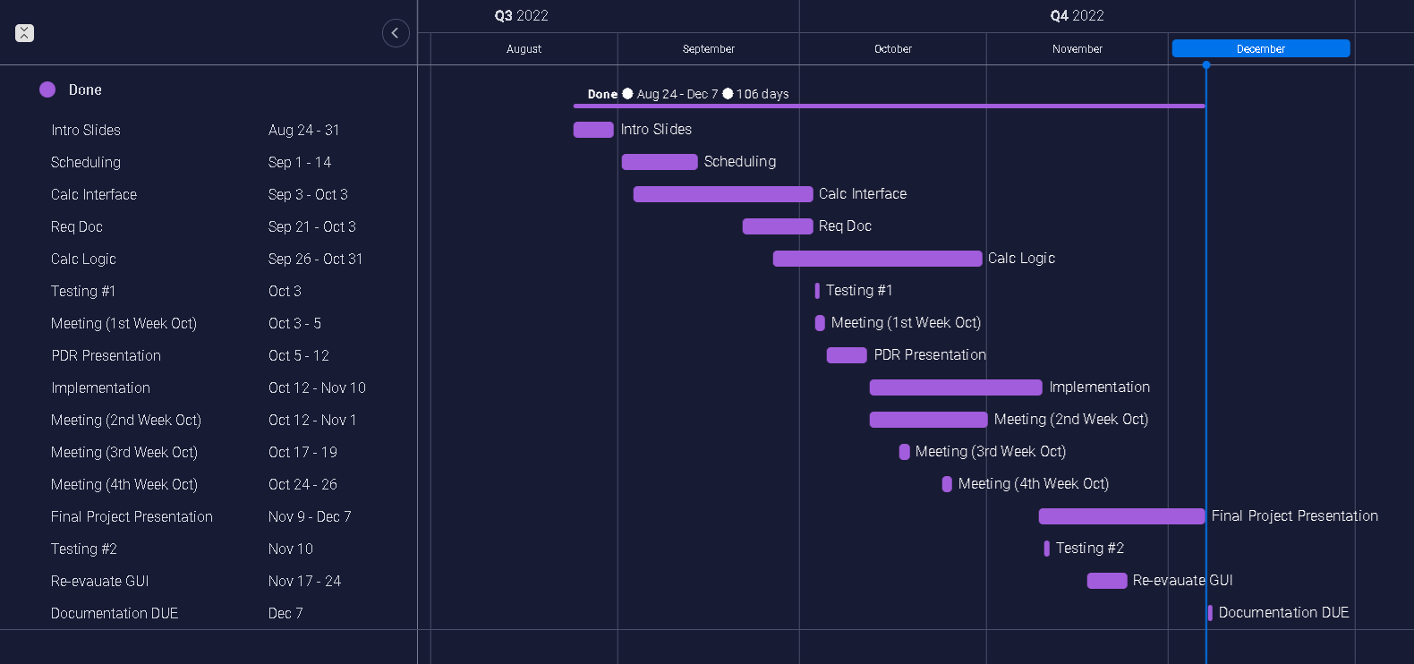
Schedule

Slide 5
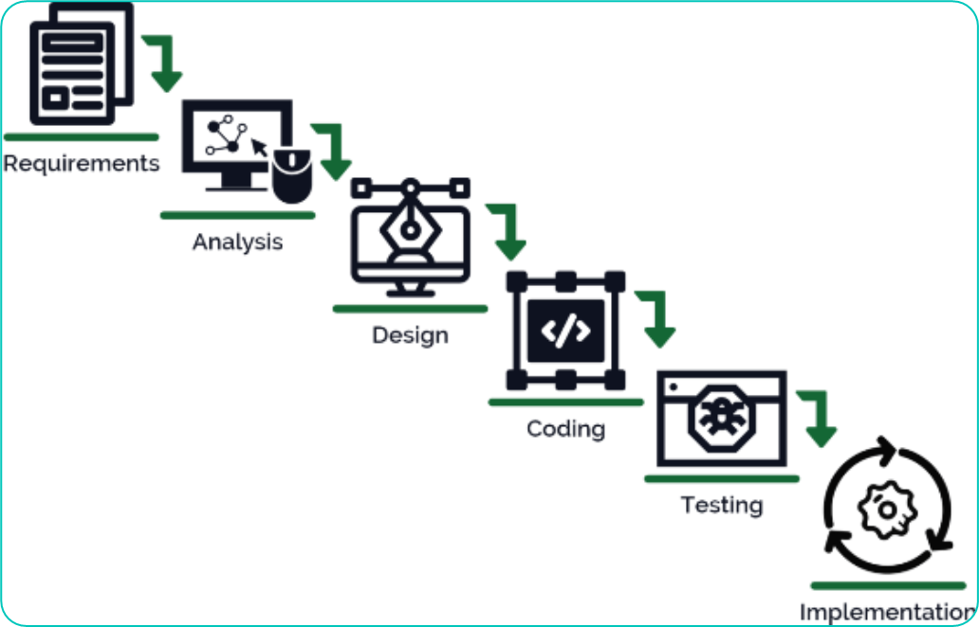
Waterfall design
Requirements (PDR Documents)
Analysis
Design
Coding
Testing
Implementation(programming)
Phases do not overlap; They are completed one at a time.

Slide 6
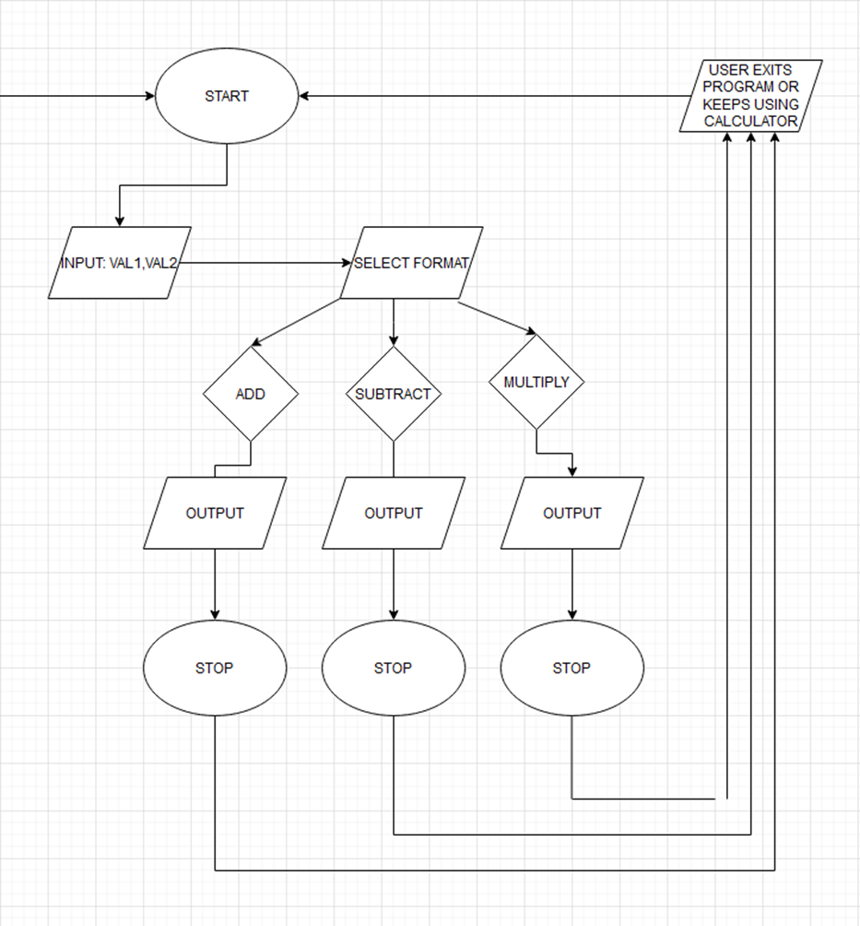
Design phase

Slide 7
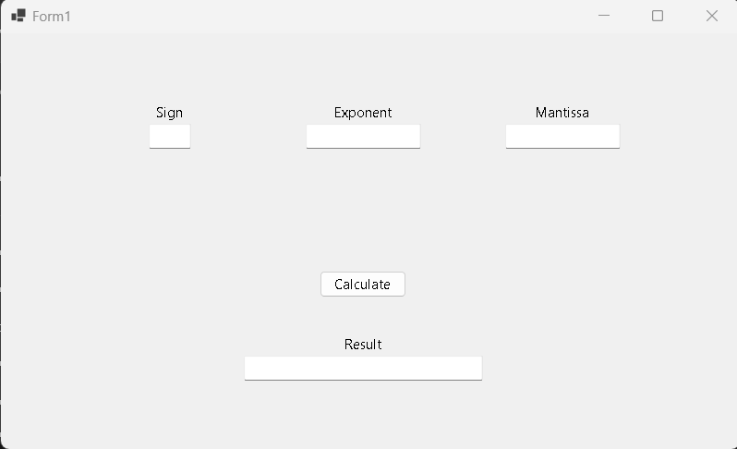
Black box testing

Slide 8
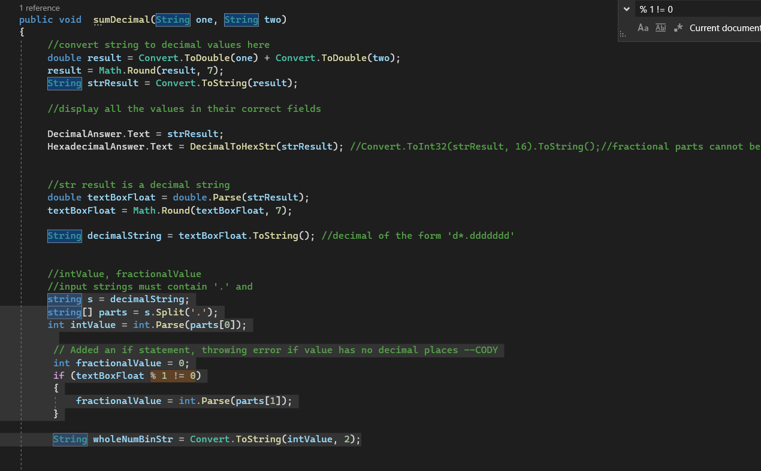
Coding standard
Comments
Organizing similar methods in sections
Separating functions between methods
Removing redundancy
Error handling mechanisms

Slide 9
Issues encountered
Converting binary to hex
Implementing Accessibility options( large font)
Binary with decimal places
Error checks
Updating adjustments

Slide 10
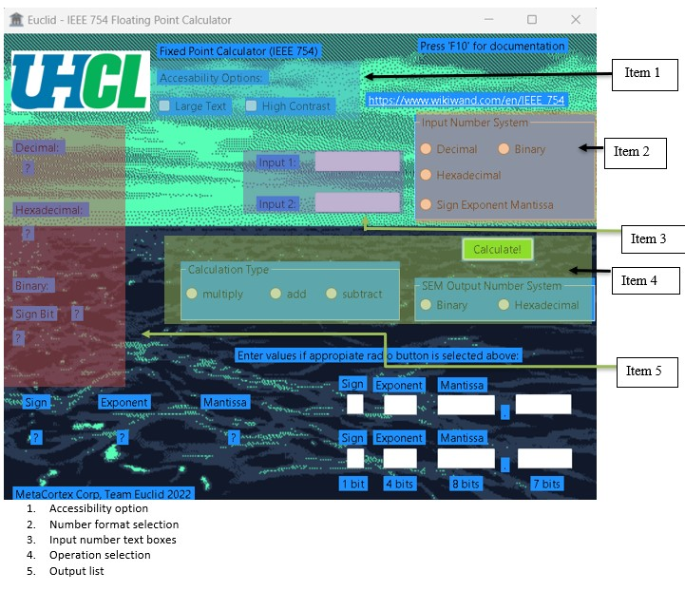
How it works

Slide 11
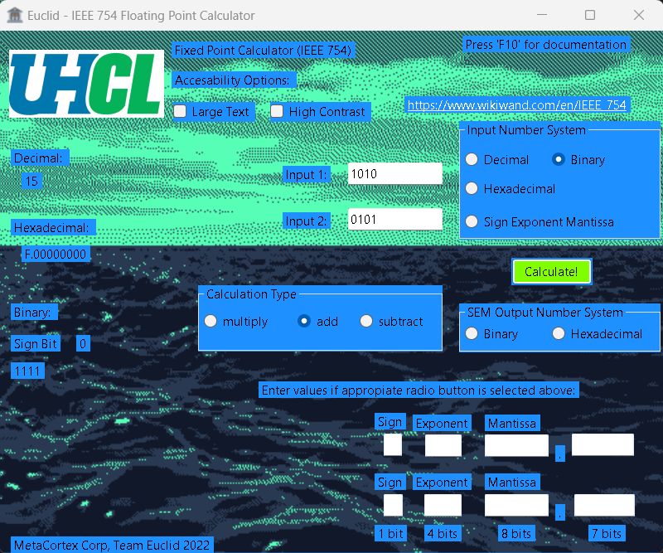
Example 1
Non sign exponent
Mantissa calculations

Slide 12
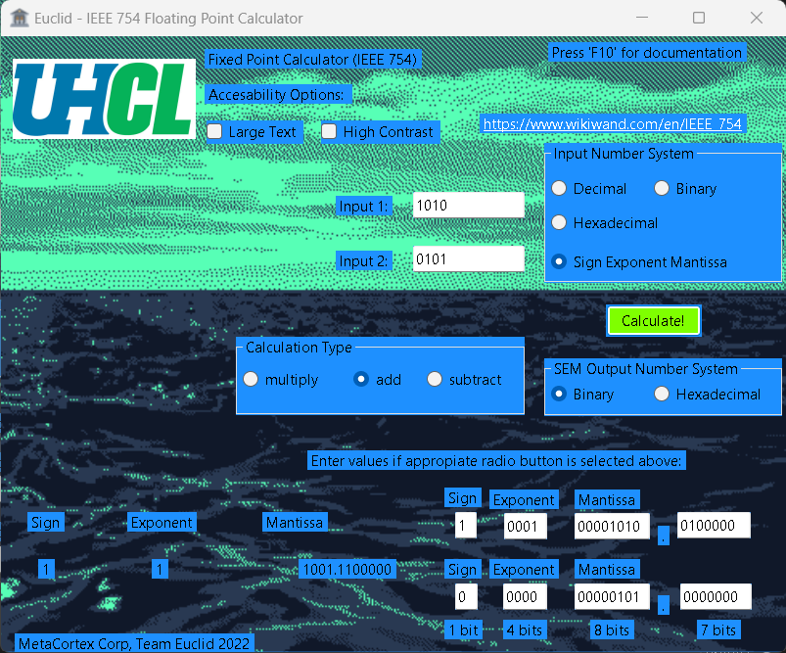
Example 2
Sign exponent
Mantissa calculations

Slide 13
DEMO TIME
Instructions:
Settings -> Display -> Size(175%)
Run “(SWEN 4342) Floating Point Calculator [Final Project].exe”

